Slide 1

MHV on VA.gov
IA testing – Round 2

Slide 2

How this research maps to the Veteran journey
Title of the research | mm dd, yyyy
Attending to health needs
Recognizing and addressing mental health needs
Managing primary care and chronic health issues
Taking care of my health
Managing my declining health
Reinventing myself
Joining
Serving
Getting out
Starting up
Taking care of myself
Retiring
Aging
Dying
Putting down roots
For a fully detailed Veteran journey, go to https://github.com/department-of-veterans-affairs/va.gov-team/blob/master/platform/design/va-product-journey-maps/Veteran%20Journey%20Map.pdf
Serving and separation
Living civilian life
Retiring and aging

Slide 3
OCTO-DE goals that this research supports
Title of the research | mm dd, yyyy
Supported
Not supported
Veterans and their families can apply for all benefits online
Veterans and their families can find a single, authoritative source of information
Veterans and their families trust the security, accuracy, and relevancy of VA.gov
Veterans can manage their health services online
VFS teams can build and deploy high-quality products for Veterans on the Platform
Logged-in users have a personalized experience, with relevant and time-saving features
Logged-in users can update their personal information easily and instantly
Logged-in users can easily track applications, claims, or appeals online
Completion rate of online transactions
Percent of applications submitted online (vs. paper)
Veteran satisfaction with VA.gov
Benefit use and enrollment, across all business lines
Benefit value (in $) delivered from online applications or transactions
Number of VA.gov users as a function of total Veteran population
Usage of digital, self-service tools
Measures to increase
Time to successful complete and submit online transactions
Time to process online applications (vs. paper)
Call center volume, wait time, and time to resolution
Time from online benefit discovery to benefit delivery
Measures to decrease

Slide 4
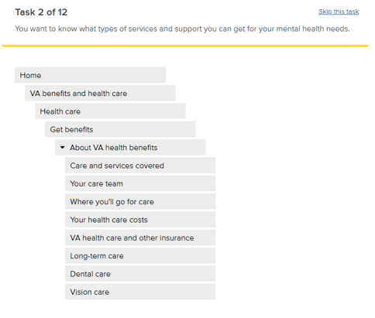
Methodology
We conducted 2 unmoderated tree tests utilizing Optimal Workshop’s Tree jack tool
Participants were asked to complete 12 tasks by navigating a menu structure and indicating wher ethey would be able to find the answer
Of the 12 tasks, 6 tasks were related to learning about or applying for health care benefits, and 6 tasks were related to managing a person’s health care or health care benefit
Tasks were randomized to avoid bias from learning the tree as the test progressed
Participants were allowed to skip tasks to allow if needed, however participants that skipped 100% of the tasks were excluded from results
Example tree test task

Slide 5
Participants
Veterans
6 cohorts for 48 completions
3 cohorts enrolled in VA health care (26)
3 cohorts not enrolled in VA health care (22)
86 attempted, 33 abandons, 5 removed
Family/caregivers
6 cohorts for 37 completions
3 cohorts have used MHV in past 12 months
3 cohorts have not used MHV in past 12 months
52 attempted, 12 abandons, 3 removed
Demographics requested
Participants recruited represented a diverse sample of Veterans composed of varying ages, races, genders, geographical locations, education levels, and cognitive abilities.
Optimal workshop does not support assistive technology, so this test did not include participants that utilize screen readers or other assitive tech.

Slide 6
Menu items/tasks evaluated
Tasks were chosen to represent a mix of key items to the experience as well frequently accessed topics and tools.
“Get benefits” tasks
Veteran eligibility and family eligibility
Veteran apply
Mental health
Dental care
Copay rates
Community care
“Manage benefits” tasks
Share medical records
Pay copay bills
Refill prescriptions
Schedule appointment
Check lab test
Request travel reimbursement

Slide 7
Key changes to the IA from previous tests
Streamlined the health care benefit hub:
Moved supplemental content out of the “Get benefits” section and grouped options by core benefit offering – i.e. Veteran health care, Dental insurance, Mental health care, Foreign medical, Family health care
Revised the “More resources” section to a curated list of the top 10 resources and a link to see all resources – all would go to R&S
My health top level option label and order changes:
Re-ordered the top level of My health based on assumed priority and frequency of use
Changed the label of “Pharmacy” to “Prescriptions”
Split travel reimbursement out from copay bills into separate top level menu options
Split detailed health record content out from medical records and their own top level menu options
Reintroduced a “My health care” section within My health to for general benefit tasks and cross-linked key benefit content
Renamed the service member benefit hub and family member benefits hub to “Current service members” and “Family and caregivers” respectively

Slide 8
Common metrics in tree tests
Success rate: The percent of participants that selected the correct answer, regardless of how they got there.
Directness: The percent of participants that went directly to an answer without backtracking, regardless if the answer was right or wrong
These 2 metrics are most often looked at together when analyzing a tree test
A high success rate with low directness could indicate that participants had to work hard and dig around in the structure to find the answer
A low success rate and high directness could mean participants misunderstood an incorrect option or section of your tree as the correct answer (they confidently went to the wrong answer)
First click/path: The first clicks a user makes indicates where users initially expected to find the information
Other metrics:
There are other metrics used in tree testing (i.e. time taken per task, skip rate, first click, etc), however no significant patterns in these were found for this test.
Always keep in mind that all labels and parts of a structure can impact a tasks results. For example, a section of the tree may be perfectly labeled and structured, but if another part has a misleading label, it can draw visitors away.

Slide 9
Key findings
Veterans were equally successful in completing tasks regardless of VA health care enrollment status
The revised health care benefit hub IA performed the same or better than previous versions in most tasks
The family member hub plays an important role in the findability of information and tasks that family members and caregivers need
Veterans struggled to find general benefits information once within the “My health” section
Participants initially looked for test results within “Medical records” but selected answers equally as much in “Health history”
Copay rates and community care content must be prominently cross-linked from key places within the “Get health care benefits” and “My health” sections
Visitors are still not clear on where to find information on travel pay

Slide 10
Finding 1: Veterans completed tasks successfully regardless of their VA health care enrollment status
Both Veterans enrolled in VA health care and Veterans not enrolled in VA health care had similar task success rates (within 20%*) in 9/12 tasks, and 6/12 tasks had success rates > 70%
Veterans not enrolled in VA health care had significantly lower task success in tasks for mental health, community care, and labs and tests
For the mental health task, Veterans not enrolled in VA health care were divided in where they navigated first – Get health care benefits, My health, More resources and support - resulting in varied navigational paths and answers, whereas almost all Veterans enrolled in health care went directly to “Get health care benefits” and selected the correct answer
For the Community care task, 31% of Veterans not enrolled in VA health care incorrectly selected “Types of care” within the “Get health care benefits” spoke – this audience may be less familiar with the concept of community care
For the labs and tests tasks, 20% of Veterans not enrolled in VA health care selected options within “Messages” and “Appointments”
Get benefits tasks | All Veterans (48) | Enrolled in health care (22) | Not enrolled in health care (26)
Eligibility | 85% | 95% | 77%
Apply | 79% | 86% | 73%
Dental care | 90% | 95% | 85%
Mental health | 88% | 100% | 77%
Copay rates | 50% | 45% | 54%
Community care | 23% | 36% | 12%
Get benefits tasks | All Veterans (48) | Enrolled in health care (22) | Not enrolled in health care (26)
Medical records | 71% | 73% | 65%
Copay bill | 67% | 68% | 65%
Prescriptions | 85% | 86% | 85%
Appointments | 81% | 86% | 77%
Labs and tests | 81% | 100% | 65%
Travel pay | 52% | 55% | 50%
* It was assumed that Veterans not enrolled in health care would have slightly lower task success rates (within 20%) due to experience and knowledge of the benefit and information
Notes:
Hypothesis: All Veterans, regardless of their health care enrollment status, will understand that information related to applying for benefits will be within the “Get benefits” area, and information related to managing their benefits will be within the “My health” section.
Did Veterans enrolled in VA health care and Veterans not enrolled in VA health care both correctly look for information on exploring and applying for health care benefits within “Get benefits” (task success) and information on managing benefits within “My health”?
Were Veterans enrolled in VA health care and Veterans not enrolled in VA health care both equally successful in completing tasks (success rate comparison) within the “Get benefits” and “My health” sections?

Slide 11
Finding 2: The revised health care hub IA performed the same or better than previous versions in most tasks for both Veterans and family members/caregivers
Veterans in H1 had similar or higher success rates in 4/6 tasks when compared to baseline
Family/caregivers in H1 had similar or higher success rates in 5/6 tasks when compared to baseline
The community care and copay rates tasks will continue to be tested and refined for placement, labeling, and crosslinking opportunities
The percent of family/caregiver participants that incorrectly selected Veteran content to determine family member eligibility decreased in H2 (19%) compared to baseline (27%)
Audience | Veteran |  |  |  | Caregiver
Task / Test | Baseline (46) | H1 (51) | H2 (48) |  | Baseline (30) | H1 (40) | H2 (37)
Veteran eligibility | 87% | 80% | 85% |  | 60% | 73% | 73%
Family eligibility | - | - | - |  | 67% | 73% | 73%
Veteran apply | 78% | 76% | 79% |  | - | - | -
Dental care | 65% | 76% | 90% |  | 53% | 70% | 70%
Mental health | 43% | 71% | 88% |  | 37% | 70% | 70%
Community care | 48% | 63% | 23% |  | 30% | 48% | 16%
Copay rates | 70% | 67% | 50% |  | 33% | 35% | 35%
Content selected for Family/caregiver eligibility task | Baseline (30) | H2 (37)
Health care hub > Veteran content | 27% | 19%
Health care hub > Family member content | 13% | 19%
Family member hub | 53% | 57%
Notes:
Hypothesis: Moving supplemental content out of the “Get benefits” section and grouping information by core benefit offerings will help Veterans and family members more easily find information related to exploring and applying for benefits.
Did the changes improve or at least maintain the success rates/direct success of the tasks related to getting benefits?
In the caregiver test, were there fewer participants looking (first path) and selecting (success rate) Veteran content for family/caregiver information?

Slide 12
Finding 3: The family member hub plays an important role in the findability of information and tasks that family members and caregivers need
Family/caregiver participants predominantly navigated to and selected an answer in the “Family and caregiver” hub for information on health care eligibility for themselves – this has been a consistent pattern across all tests
There was a significant increase in the number of participants that first navigated to and selected answers in the “Family and caregiver” hub for the travel pay task
In H2, the word “benefits” was dropped from the hub name, and the word “caregiver” was added – these label changes may have contributed to more participants looking to the health care hub for benefit information (dental care and mental health), and to the family and caregiver hub for caregiver benefits (travel pay)
Test | Baseline (30) | H1 (40) | H2 (37)
Task / Metric | First path | First path | First path
Family eligibility | 53% Family member benefits 33% Health care | 53% Family member benefits 38% Health care | 54% Family and caregivers 35% Health care
Dental care | 53% Health care 23% Family member benefits | 50% Health care 40% Family member benefits | 59% Health care 27% Family and caregivers
Mental health | 70% Health care 10% Family member benefits | 68% Health care 15% Family member benefits | 86% Health care 5% Family and caregivers
Travel pay | 47% Health care 10% Family member benefits | 58% Health care 20% Family member benefits | 46% Health care 38% Family and caregivers
Notes:
Hypothesis: With a clearer hub name, family members and caregivers will prefer to find information related to exploring and applying for health care for themselves, as well as tasks related to managing their own health benefits, within the “Family and caregiver” benefit hub.
Did participants in the family/caregiver test more often look within (first click, paths) the “Family and caregiver” hub to complete tasks specific to their own benefits rather than the sections of the “Health care” hub?

Slide 13
Finding 4: Veterans struggled to find general benefits information once within the “My health” section of H2
Some Veterans and caregivers navigated to “My health” at some point to find benefits information related to dental care, mental health care, community care, and copay rates – information that is relevant to those already enrolled in VA health care
However, few participants navigated into the “My health benefits” section that contained the information, and even fewer selected an option once there indicating the placement and labeling may not be entirely clear
These tasks will continue to be evaluated in ongoing research for the health portal to ensure Veterans can easily find and get to supporting benefits information within the portal
Audience | Veterans | Veteran |  |  | Caregivers | Caregiver
Task / Behavior | Visited My health | Visited My health benefits | Selected answer in My health benefits |  | Visited My health | Visited My health benefits | Selected answer in My health benefits
Dental care | 23% | 17% | 8% |  | 19% | 14% | 11%
Mental health | 35% | 19% | 4% |  | 32% | 11% | 5%
Community care | 31% | 15% | 15% |  | 14% | 5% | 5%
Copay rates | 29% | 15% | 10% |  | 57% | 11% | 11%

Slide 14
Finding 5: Participants initially looked for test results within “Medical records” but selected answers equally as much in “Health history”
Participants in both groups predominantly navigated to “My health > Medical records” initially to find information on a recent lab test, and only 4% of Veterans and 19% of family/caregivers initially went to “Health history”
Of the Veteran participants that navigated to “My health > Medical records”, a significant number backed out to look in different areas - 42% of Veterans and 27% of family/caregiver participants
Ultimately, participants selected answers equally in “Medical records” and “Health history”
Task / test | Success / Directness | First path | Selections
Labs and tests
Veterans (48) | 81% / 56% | 48% Health care > My health > Medical records 27% Records 4% Health care > My health > Health history | 31% Health care > My health > Medical records > Download my medical record (Blue Button) 29% Health care > My health > Health history > Labs and tests 21% Records > Get medical record
Caregivers (37) | 97% / 73% | 46% Health care > My health > Medical records 19% Health care > My health > Health history 16% Records | 43% Health care > My health > Medical records > Download my medical record (Blue Button) 38% Health care > My health > Health history > Labs and tests 16% Records > Get medical records
Notes:
Hypothesis: Participants will look in “Health history” to answer general questions about their health instead of looking to download their entire health record.
Did participants primarily look (first click) within “Health history” to answer general health data questions more so than the “Medical records” option?
Did participants more often select options (top destinations) outside of downloading their medical record to complete tasks related to their health?

Slide 15
Finding 6: Visitors are still not clear on where to find information on travel pay
While the travel pay tasks success rates improved over the previous H1 test, they are still significantly lower than the baseline scores
In both tests, once a participant navigated into My health, they all proceeded to select the correct answer – however, there was not an overwhelming percentage of participants that immediately went to “My health” for this task indicating participants do not have confidence in where to go first
A significant number of family/caregivers participants went directly to the “Family and caregiver” hub to complete this task
There was a significant reduction in the percentage of Veterans that looked in the “Current service members” hub in this test (4%) compared to the “Service member benefits” hub in baseline (26%) and H1 (24%)
Travel pay – H2 | Success / Directness | First path | Selections
Veterans (48) | 52% / 56% | 38% Health care > My health 15% [x] Health care > Get health care benefits 17% [x] Health care > More resources and support | 52% Health care > My health > Travel reimbursement 13% [x] Health care > More resources and support > [various answers] 10% [x] Find a VA location > [ VA benefits and Vet Centers]
Caregivers (37) | 35% / 51% | 38% [x] Family and caregivers 22% Health care > My health 19% [x] Health care > More resources and support | 35% Health care > My health > Travel reimbursement 32% [x] Family and caregivers > [various answers] 19% [x] Health care >More resources and support > [various answers]
[x] Indicates an incorrect path or selection
Travel pay - Task success across tests | Baseline | H1 | H2
Veterans | 67% | 39% | 52%
Family/caregivers | 43% | 28% | 35%

Slide 16
Finding 7: Copay rates and community care content must be prominently cross-linked from key places in both the “Get health care benefits” and “My health” sections
In both tasks, audiences primarily looked in the “Get health care benefits” area first, however there was also a significant number of participants that looked within “My health” in their first clicks.
For community care, participants who did navigate to “More resources and support” (the correct section), often selected incorrect answers there – 13% in the Veteran test, and 24% in the family/caregiver test
For copay rates, those that looked within “My health” rarely found the correct answer there – only 6% of Veterans, and 8% of family/caregivers
Task / test | Success / Directness | First path | Selections
Community care
Veterans (48) | 23% / 58% | 33% [x] Get health care benefits 23% More resources and support 23% [x] My health | 23% More resources and support > Eligibility for VA community care 23% [x] Get health care benefits > Veteran health care > Types of care 15% [x] My health > My health benefits > Veteran care and services
Caregivers (37) | 16% / 68% | 41% [x] Get health care benefits 32% More resources and support 11% [x] My health | 27% [x] Get health care benefits > Veteran health care > Types of care 16% More resources and support > Eligibility for VA community care
Copay rates
Veterans (48) | 67% / 73% | 50% Get health care benefits 23% My health 17% [x] More resources and support | 44% Get health care benefits > Veteran health care > Copay rates 23% [x] More resources and support > [various incorrect answers]
Caregivers (37) | 54% / 76% | 32% Get health care benefits 32% My health 19% [x] More resources and support | 35% [x] My health > Copay bills 27% Get health care benefits > Veteran health care > Copay rates 16% [x] More resources and support > [various answers]
[x] Indicates an incorrect path or selection

Slide 17
Recommendations
Consider building out and testing a more robust experience within the family and caregiver benefit hub that includes both information on benefits as well as tasks that family members may need to complete related to their own benefits or benefits they receive for caring for their veteran (i.e. travel pay, apply for transferred benefits, add a dependent, etc)
Consider testing a combined section that includes the content in “Health history” and “Medical records” given they ultimately provide the same information
Add a section on where to get care, including in the community, to the main Veteran health care page in addition to testing alternative labels to “community care” that all audiences would be familiar with
Continue to evaluate the labeling, organization, and design opportunities, to improve the findability of core health care benefit information such as community care, mental health care, dental care, and copay rates within “My health”
Crosslink travel pay in key areas such as “More resources”, “Family and caregiver hub”, and content pages with “Get benefits”
Move to qualitative testing of the IA within a designed experience

Slide 18
Appendix – Task data

Slide 19
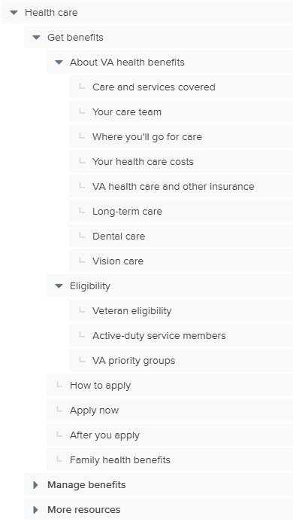
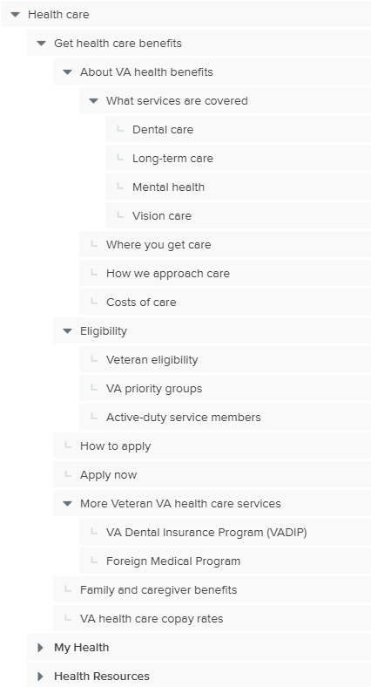
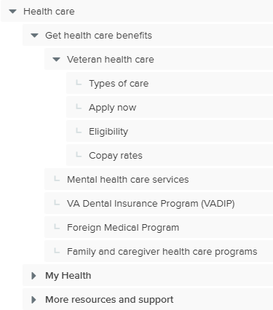
Information architecture evaluated – Get benefits
Current state (baseline)
Hypothesis (H1)
Hypothesis 2 (H2)

Slide 20
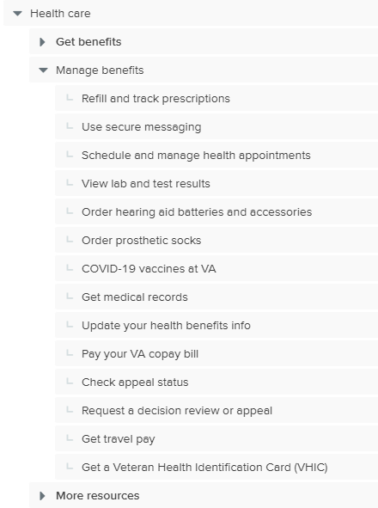
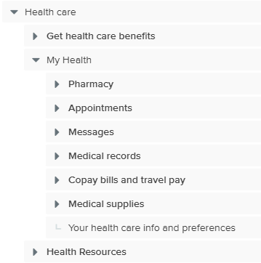
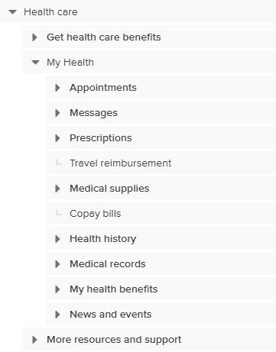
Information architecture evaluated – My health
Current state (baseline)
Hypothesis (H1)
Hypothesis 2 (H2)

Slide 21
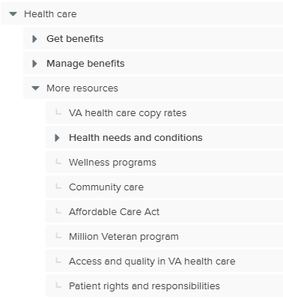
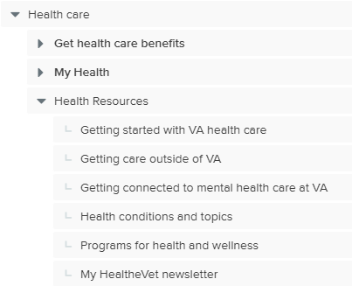
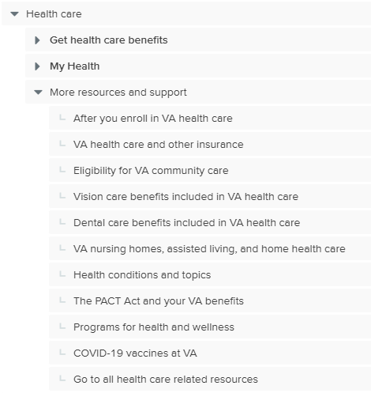
Information architecture evaluated – More resources
Current state (baseline)
Hypothesis (H1)
Hypothesis 2 (H2)

Slide 22
Overall results
Test | Veteran |  | Caregiver
 | Success | Directness | Success | Directness
Get benefits task | 69% | 69% | 68% | 69%
Veteran eligibility | 85% | 77% | 73% | 76%
Family eligibility | - | - | 73% | 86%
Veteran apply | 79% | 81% | - | -
Dental care | 90% | 75% | 70% | 81%
Mental health | 88% | 58% | 70% | 68%
Community care | 23% | 58% | 16% | 68%
Copay rates | 50% | 67% | 35% | 51%
Manage benefits task | 73% | 72% | 70% | 70%
Medical records | 71% | 75% | 84% | 84%
Copay bill | 67% | 73% | 54% | 76%
Prescriptions | 85% | 88% | 76% | 70%
Messaging | - | - | - | -
Travel pay | 52% | 56% | 35% | 51%
Appointments | 81% | 83% | 76% | 65%
Labs and tests | 81% | 56% | 97% | 73%
Veteran task performance
Success > 70%: 8/12
Success > 85%: 4 tasks
Success < 35%: 1 task
Caregiver task performance
Success > 70%: 8/12 tasks
Success > 85%: 1 task
Success < 35%: 3 tasks

Slide 23
Overall results – benchmarking against previous tests
Test | Veteran |  |  |  |  |  | Caregiver
 | Baseline |  | H1 |  | H2 |  | Baseline |  | H1 |  | H2
 | Success | Direct | Success | Direct | Success | Direct | Success | Direct | Success | Direct | Success | Direct
Get benefits | 65% | 62% | 72% | 65% | 69% | 69% | 47% | 61% | 68% | 61% | 68% | 69%
Veteran eligibility | 87% | 72% | 80% | 73% | 85% | 77% | 60% | 77% | 73% | 65% | 73% | 76%
Family eligibility | - | - | - | - | - | - | 67% | 83% | 73% | 68% | 73% | 86%
Veteran apply | 78% | 80% | 76% | 71% | 79% | 81% | - | - | - | - | - | -
Dental care | 65% | 59% | 76% | 67% | 90% | 75% | 53% | 47% | 70% | 63% | 70% | 81%
Mental health | 43% | 48% | 71% | 47% | 88% | 58% | 37% | 43% | 70% | 48% | 70% | 68%
Community care | 48% | 48% | 63% | 51% | 23% | 58% | 30% | 53% | 16% | 50% | 16% | 68%
Copay rates | 70% | 65% | 67% | 78% | 50% | 67% | 33% | 63% | 35% | 70% | 35% | 51%
Manage benefits | 79% | 60% | 67% | 70% | 73% | 72% | 65% | 60% | 51% | 65% | 70% | 70%
Medical records | 87% | 61% | 69% | 86% | 71% | 75% | 87% | 73% | 70% | 83% | 84% | 84%
Copay bill | 87% | 72% | 69% | 73% | 67% | 73% | 57% | 73% | 30% | 65% | 54% | 76%
Prescriptions | 89% | 76% | 82% | 75% | 85% | 88% | 83% | 63% | 68% | 70% | 76% | 70%
Messaging | 65% | 52% | 76% | 75% | - | - | 57% | 53% | 60% | 70% | - | -
Travel pay | 67% | 41% | 39% | 41% | 52% | 56% | 43% | 37% | 28% | 38% | 35% | 51%
Appointments | - | - | - | - | 81% | 83% | - | - | - | - | 76% | 65%
Labs and tests | - | - | - | - | 81% | 56% | - | - | - | - | 97% | 73%
Veteran task performance
Improved: 2 tasks
Flat: 3 tasks
Declined: 5 tasks
Caregiver task performance
Improved: 3 tasks
Flat: 5 tests
Declined: 2 tests
Tasks are considered improved or declined if there is a 10% or more difference between the results, otherwise they are considered flat.
Notes:
When comparing results, a 10% threshold is used to ensure we are identifying differences that indicate a trend versus those as a result of 1-2 participants.

Slide 24
Veteran results - General observations
* = >20% lower than the other segment
Get benefits tasks | All Veterans (48) | Observations on paths taken | Observations on answers selected
Overall | 69% / 69% | First paths: 55% Get health care benefits 17% My health 14% More resources and support | 20% of all answers selected were under “More resources and support” – ½ were incorrect 8% of all answers selected were under “My health” There were very few options selected in “Current service members” compared to previous tests.
Eligibility | 85% / 77% | 12% went to “About VA” first – all were in the group that are not enrolled in VA health care | 14% selected “Apply now”
Apply | 79% / 81%
Dental care | 90% / 75% | 23% of Veterans went to My health first 6% of Veterans went to Disability first - all were enrolled in VA health care | 50% of the correct selections was the VADIP option
Mental health | 88% / 58% | 27% of all Veterans went to “My health” first and 23% went to “More resources and support”. 13% of those that went to “My health” immediately backed out of the section, and almost all paths were indirect | 25% of the answers were in “More resources and support”
Copay rates | 50% / 67% | 23% of Veterans went to “My health” first and 17% went to “More resources and support; those paths tended to be more indirect | 23% selected incorrect answers under “More resources and support”
Community care | 23% / 58% | 33% Get health care benefits 25% More resources and support 23% My health | 33% selected incorrect answers under “Get health care benefits”, 23% incorrectly selected “Get health care benefits > Veteran health care > Types of care” 15% incorrectly selected “My health > My health benefits > Veteran care and services” 38% selected an option related to the types of care you receive
Notes:
* It is expected that those participants not enrolled in VA health care would have somewhat lower success rates given less familiarity with the benefit and information.

Slide 25
Veteran results - by Enrollment status
* = >20% lower than the other segment
Get benefits tasks | Enrolled in health care (22) |  |  | Not enrolled in health care (26)
- Location of correct answers | S / D | First path | Top answers (>10%) | S / D | First path | Top answers (>10%)
Get benefits Overall | 76% / 69% | 62% Get health care 14% My health 14% More resources |  | 63% / 70% | 48% Get health care 19% My health 15% More resources
Eligibility – - Get health care benefits | 95% / 86% | 91% Get health care benefits 5% My health 0% More resources and support 5% About VA | 77% Health care > Get health care benefits > Veteran health care > Eligibility 18% Health care >Get health care benefits > Veteran health care > Apply now | 77% / 69% | 69% Get health care benefits 0% My health 12% About VA | 65% Health care > Get health care benefits > Veteran health care > Eligibility 12% Health care >Get health care benefits > Veteran health care > Apply now
Apply - Get health care benefits | 86% / 82% | 82% Get health care benefits 5% My health 0% More resources and support 9% Current service members 5% About VA | 77% Health care > Get health care benefits > Veteran health care > Apply now | 73% / 81% | 62% Get health care benefits 19% More resources and support | 62% Health care > Get health care benefits > Veteran health care > Apply now 12% Health care > Get health care benefits > Veteran health care > Eligibility
Dental care - Get health care benefits - My health - More resources and support | 95% / 68% | 55% Get health care benefits 18% My health 14% More resources and support 14% Disability | 55% Health care > Get health care benefits > VA Dental Insurance Program (VADIP) 18% Health care > More resources and support > Dental care benefits included in VA health care 14% Health care >Get health care benefits > Veteran health care > Types of care | 85% / 81% | 50% Get health care benefits 27% My health 12% More resources and support | 46% Health care > Get health care benefits > VA Dental Insurance Program (VADIP) 15% Health care > More resources and support > Dental care benefits included in VA health care 12% Health care > My health > My health benefits > Veteran care and services covered

Slide 26
Veteran results - by Enrollment status
* = >20% lower than the other segment
Get benefits tasks | Enrolled in health care (22) |  |  | Not enrolled in health care (26)
- Location of correct answers | S / D | First path | Top answers (>10%) | S / D | First path | Top answers (>10%)
Get benefits Overall | 76% / 69% | 62% Get health care 14% My health 14% More resources |  | 63% / 70% | 48% Get health care 19% My health 15% More resources
Mental health - Get health care benefits - My health - More resources and support | 100%/64% | 55% Get health care benefits, 23% My health 18% More resources and support 5% [x] About VA | 77% Health care > Get health care benefits > Mental health care services | * 77% / 54% | 27% Get health care benefits 31% My health 27% More resources and support | 54% Health care > Get health care benefits > Mental health care services 19% Health care > More resources and support > Health conditions and topics 12% [x] Health care > More resources and support > Go to all health care related resources
Copay rates - Get health care benefits - My health | 45% / 59% | 55% Get health care benefits, 18% My health 18% More resources and support 5% About VA | 41% Health care > Get health care benefits > Veteran health care > Copay rates 18% Health care > More resources and support > VA health care and other insurance | 54% / 73% | 46% Get health care benefits 27% My health 15% More resources and support | 46% Health care > Get health care benefits > Veteran health care > Copay rates 15% Health care > More resources and support > Go to all health care related resources 8% Health care > My health > My health benefits > Veteran copay rates
Community care - More resources and support | 36% / 55% | 36% [x] Get health care benefits 32% More resources and support 14% [x] My health 9% Current service members 5% [x] Disability | 36% Health care > More resources and support > Eligibility for VA community care 18% [x] Health care > My health > My health benefits > Veteran care and services covered 14% [x] Health care > Get health care benefits > Veteran health care > Types of care | * 12% / 62% | 31% Get health care benefits 31% My health 15% More resources and support | 31% [x] Health care > Get health care benefits > Veteran health care > Types of care 12% Health care > More resources and support > Eligibility for VA community care 12% [x] Health care > My health > My health benefits > Veteran care and services covered

Slide 27
Veteran results - by Enrollment status
* = >20% lower than the other segment
Manage benefits tasks | Enrolled in health care (22) |  |  | Not enrolled in health care (26)
- Location of correct answers | S / D | First path | Top answers (>10%) | S / D | First path | Top answers (>10%)
Manage benefits Overall | 78% / 71% | 57% My health 8% Get health care benefits 7% More resources and support |  | 68% / 73% | 56% My health 7% Get health care benefits 3% More resources and support
Medical records - 71% / 75% - My health - Records hub | 73% / 82% | 50% Records hub 36% My health | 41% Health care > My health > Medical records > Share my health summary with a non-VA provider 27% Records > Get your records and documents > Get medical records 18% Records > Get your records and documents > Request your military records | 65% / 69% | 46% Records hub 35% My health | 31% Health care > My health > Medical records > Share my health summary with a non-VA provider 31% Records > Get your records and documents > Get medical records 8% Records > Get your records and documents > Get your military records
Copay bill - 67% / 73% - My health | 68% / 68% | 45% My health 23% More resources 14% Records hub | 68% Health care > My health > Copay bills | 65% / 77% | 54% My health 19% Get benefits | 65% Health care > My health > Copay bills 12% selected an answer under Get health care benefits > Veteran health care
Prescriptions – 85% / 88% - My health | 86% / 91% | 91% My health | 86% Health care > My health > Prescriptions > Refill a prescription | 85% / 85% | 81% My health 12% Get benefits | 85% Health care > My health > Prescriptions > Refill a prescription

Slide 28
Veteran results - by Enrollment status
* = >20% lower than the other segment
Manage benefits tasks | Enrolled in health care (22) |  |  | Not enrolled in health care (26)
- Location of correct answers | S / D | First path | Top answers (>10%) | S / D | First path | Top answers (>10%)
Prescriptions – 85% / 88% - My health | 86% / 91% | 91% My health | 86% Health care > My health > Prescriptions > Refill a prescription | 85% / 85% | 81% My health 12% Get benefits | 85% Health care > My health > Prescriptions > Refill a prescription
Appointments – 81% / 83% - My health | 86% / 82% | 68% My health 23% Get benefits | 86% Health care > My health > Appointments > Schedule a new appointment | 77% / 85% | 73% My health 12% Get benefits 8% Find a VA location | 77% Health care > My health > Appointments > Schedule a new appointment 8% selected to “Start a new message”
Labs and tests – 81% / 56% - My health - Records hub | 100% / 55% | 68% My health 23% Records hub | 59% Health care > My health > Download my medical record (Blue Button) 32% Health care > My health > Health history > Lab and test results 9% Records > Get your records and documents > Get medical records | * 65% / 58% | 58% My health 35% Records hub | 31% Records > Get your records and documents > Get medical records 27% Health care > My health > Health history > Lab and test results 12% [x] selected an option under My health > Messages
Travel pay – 52% / 56% -My health | 55% / 50% | 36% My health 23% Get benefits 18% More resources | 55% Health care > My health > Travel reimbursement 14% Health care > More resources and support > Go to all health care related resources | 50% / 62% | 35% My health 15% More resources | 50% Health care > My health > Travel reimbursement 12% selected an answer under Health care > More resources and support

Slide 29
Caregiver test – General observations
Get benefits tasks | All Veterans (48) |  | First path | Selections
Overall | 68% | 69%
Veteran eligibility | 73% ⬆ | 76%
Family eligibility | 73% | 86%
Dental care | 70% ⬆ | 81%
Mental health | 70% ⬆ | 68%
Copay rates | 35% | 51% | 32% “Get health care benefits” 32% My health 19% More resources and support | 35% Copay bills 16% More resources and support”
Community care | 16% ⬇ | 68% | 41% Get health care benefits 11% My health 32% More resources and support | 27% [x] Get health care benefits > Veteran health care > Types of care 24% selected an incorrect answer under “More resources and support”
Notes:
* It is expected that those participants not enrolled in VA health care would have somewhat lower success rates given less familiarity with the benefit and information.

Slide 30
Caregiver test – General observations
Get benefits tasks | All Veterans (48) |  | Observations on paths taken | Observations on answers selected
Overall/average | 70% | 70%
Medical records | 84% | 84%
Copay bill | 54% | 76% | 43% My health 16% More resources and support 16% [x] Records hub 8% Get health care benefits | 54% My health > Copay bills 16% [x] More resources and support > [various answers] 11% [x] Get health care benefits > [various answers] 11% [x] Records > Get your records and documents > View VA payment history
Prescriptions | 76% | 70%
Travel pay | 35% | 51%
Appointments | 76% | 65%
Labs and tests | 97% | 73%
Notes:
* It is expected that those participants not enrolled in VA health care would have somewhat lower success rates given less familiarity with the benefit and information.

Slide 31
Caregiver results – Hub traffic comparison
⬆ = > 10% higher than baseline ⬇ = >10% lower than baseline Bold + highlight = highest success rate
Get benefits | Baseline (30) |  | H1 (40) |  | H2 (37)
 | Health care | Family member benefits | Health care | Family member benefits | Health care | Family and caregiver
Family eligibility | 33% first path 43% selected 13% Family health benefits | 53% first path 53% selected | 38% first path 38% selected 13% Family and caregiver benefits | 53% first path 60% selected | 35% first path 38% selected 19% Family and caregiver health care | 54% first path 57% selected
Dental care | 53% first path 57% selected 17% Family health benefits 10% Dental care | 23% first path 27% selected | 50% first path 48% selected 13% VADIP 10% Family and caregiver benefits | 40% first path 38% selected | 59% first path 65% selected 41% VADIP ⬇ 5% Family and caregiver health care | 27% first path 30% selected
Mental health | 70% first path 87% selected 33% More resources content 10% Family health benefits | 10% first path 7% selected | 68% first path 68% selected 43% More resources content 3% Family and caregiver benefits | 15% first path ⬆ 18% selected | 86% first path 86% selected 65% Mental health 11% More resources content ⬇ 0% Family and caregiver health care | 5% first path 5% selected
Travel pay | 47% first path 13% Manage benefits 17% Get benefits 17% More resources 57% selected | 10% first path 23% selected | 58% first path 33% Get benefits 13% More health resources 10% My health 63% selected | ⬆ 20% first path 23% selected | 46% first path 57% selected ⬆ 22% My health 19% More resources ⬇ 5% Get health care benefits | ⬆ 38% first path ⬆ 32% selected

Slide 32
Hypotheses and additional questions
Hypothesis/question
With a clearer hub name, family members and caregivers will prefer to find information related to exploring and applying for health care for themselves, as well as tasks related to managing their own health benefits, within the “Family and caregiver” benefit hub.
Moving supplemental content out of the “Get benefits” section and grouping information by core benefit offerings will help Veterans and family members more easily find information related to exploring and applying for benefits
Participants will look in “Health history” to answer general questions about their health instead of looking to download their entire health record.
All Veterans, regardless of their health care enrollment status, will understand that information related to applying for benefits will be within the “Get benefits” area, and information related to managing their benefits will be within the “My health” section.
Community care content was exclusively located within “More resources and support” in H2. How did the performance on this task change? Where did participants primarily look for this content?
How often was VADIP selected over core “Types of care” information for the dental task
Copay bills was split out from travel pay option at the top of the My health section, did this have any impact the success rate of either the copay bill or travel pay task?
Changed “Pharmacy” to “prescriptions” and moved it down in the hierarchy. Ensure no significant detriment to the refill prescriptions task
Did Veterans explore the new “My health benefits” section for tasks related general benefits information – copay rates, eligibility, apply, mental health, dental, community care?
Did updating the labeling of the service member hub to “Current service members” reduce the amount of times Veterans looked to that hub to complete tasks related getting benefits?
Notes:
Original hypothesis wording:
Veterans who have health care benefits account will go to My Health directly for finding information and managing health instead of browsing on VA.gov.
Grouping and prioritizing all health care benefits programs (such as mental health and dental insurance) will help Veterans and caregivers and families easily find benefits information for their needs
Viewing popular categories for medical records instead of downloading the full records will help Veterans quickly locate their health information.
Families and caregivers will prefer to find their benefits under family hub.

